Slide 1


Fast Revision + Survey 2015: v2c4, v1c8
BoP #; ECB
Gold Schemes
IMF Reforms
WTO Nairobi
Mauritius DTAA
E-Commerce

Slide 2
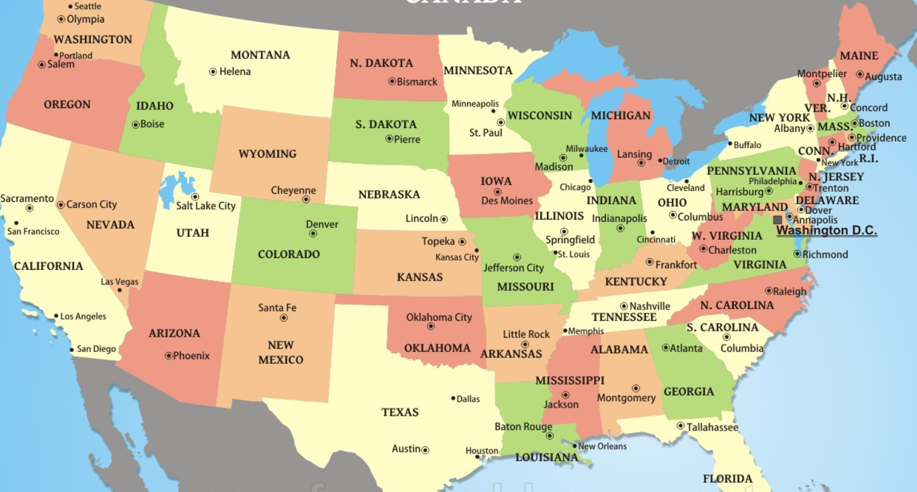
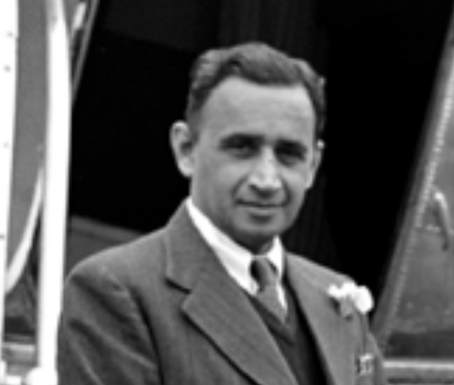
Bretton woods, 1944
Sir C D Deshmukh
1st Indian Gov of RBI
Notes:
Sir CD Deshmukh
1st Indian Gov. of RBI

Slide 3
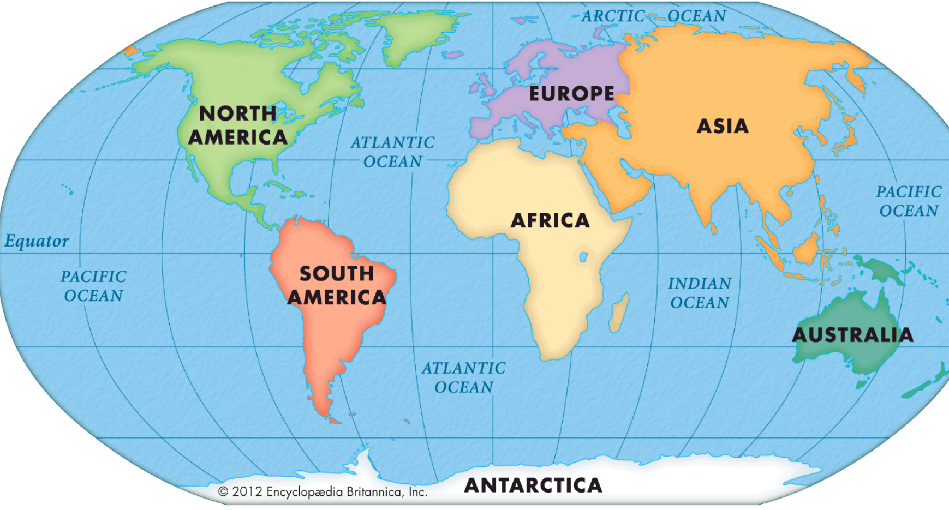


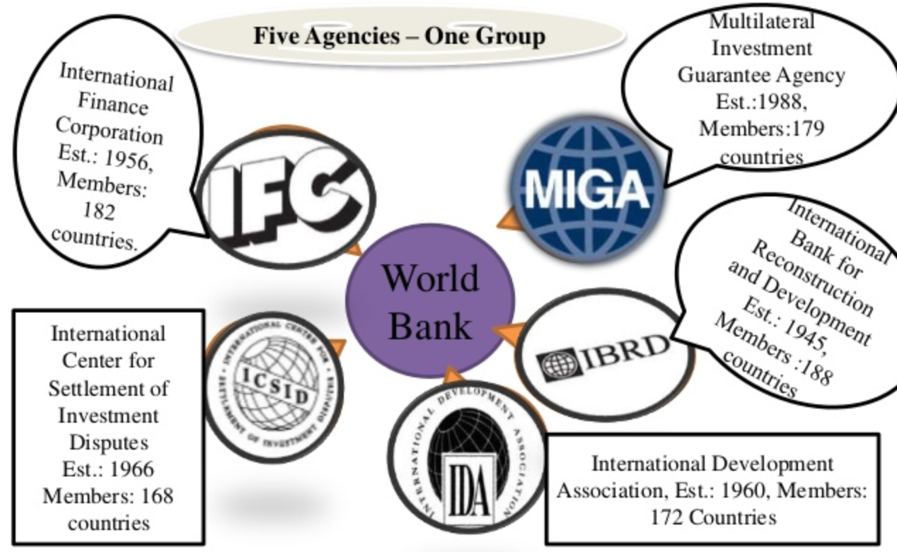

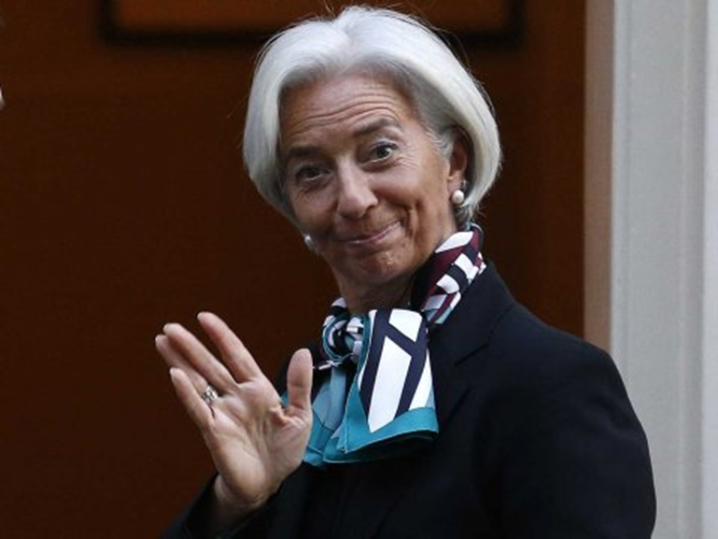
GATT’48►WTO’95
Roberto Azevedo, 164
GENEVA
Latest Afghanistan,
Dec/2015
WASHINGTON
Jim Yong Kim, 188
Christine Lagarde, 189
Notes:
World bank July 1944

Slide 4
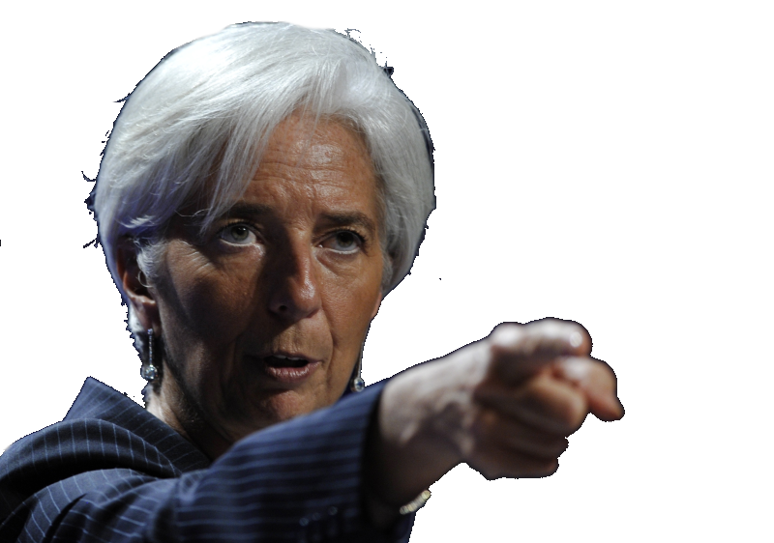
IMF reforms: Theory (L3/P5)
AIIB, BRICS Bank self-study
Yuan Inclusion
Quota Reforms
Executive Directors

Slide 5
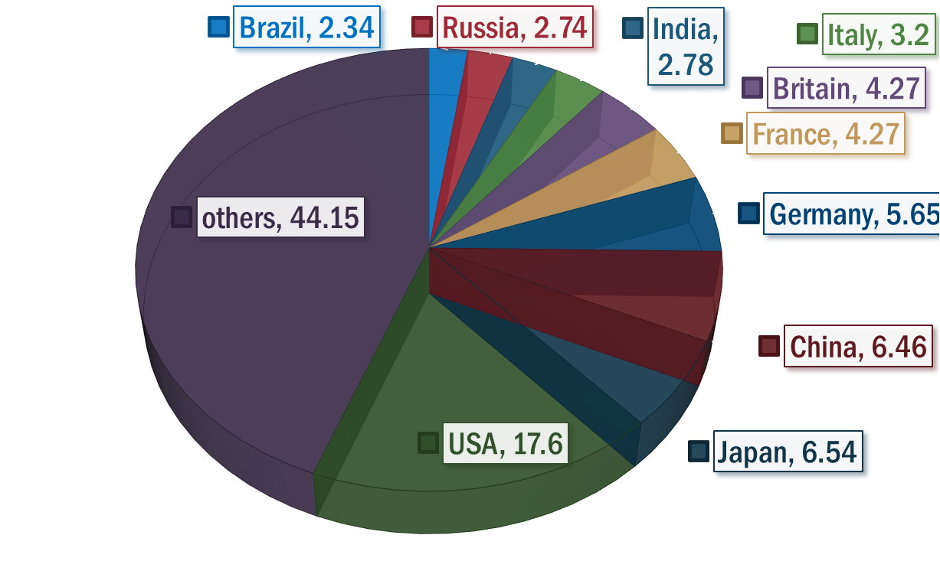


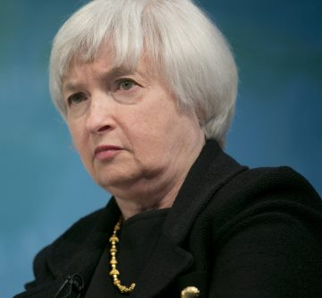
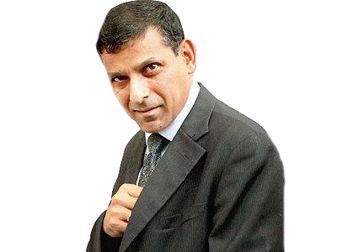
IMF: help Members during BoP crisis
Member Nation’s quota= based on size of economy
DEPOSIT
0.05%
Lending
1.05%
Reverse Tranche Position = ~25% portion kept with member. Freely exchangeable.

Slide 6
SDR: weight assigned to 4 currency
BASKET
1. Yen
Wt. (size of economy)
9.4
11.3
Exchange rate
$1=$1
2. Pound
3. Euro
4. Dollar
37.4
41.9
Wt x Rate
1SDR=$1.4 May 2016
Total wt.= 100%
Notes:
Yen exchange ultaa
https://www.imf.org/external/np/fin/data/rms_sdrv.aspx
http://www.imf.org/external/np/exr/facts/sdr.htm

Slide 7

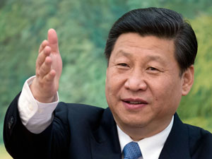
Two conditions to join IMF-SDR reserve currency
Widely used Currency (Yes, China is Major exporter)
Freely usable (need not to be fully convertible but open up)
Notes:
China places caps on how much cash its residents can take out of the country; forces international companies to do extensive paperwork before bringing large sums in; and limits foreigners to strict quotas for investing in its capital markets.
Only a small group of about 300 “qualified foreign institutional investors” have been approved to buy into China’s securities markets; their $100 billion in investments accounts for less than 3 percent of China’s stock and bond markets. As a result of these constraints, the RMB likely accounts for less than 5 percent of turnover in global foreign exchange markets

Slide 8


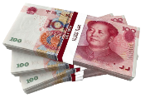
Yuan Exchange rate regime
Upto 2005
Fixed exchange rate regime: $1=8.2 Yuan
2005-15
2015
PBC changes policy: midpoint = closing trade of previous day = more aligned with “market forces.”
lowering midpoint = devaluation.
& intervenes if 2% in either direction of mid-point
PBC sets midpoint $1=~6 Yuan
This combined with other technical reforms = IMF audition pass
SELF STUDY: ML5/P4
Notes:
Until 2005: fixed exchange rate 1$=8.2 Yuan.
PBC would buy/sell yuan/dollars to ensure this rate is maintained.
2005: basket of currencies- but still daily micro-management continues. PBC decides mid-point, 2% each direction.
2015: 1$=~6 yuan. But PBC lowers the mid-point =devaluation.
Official reason: daily mid-pt. to be based on previous day’s closing value. “yuan” can move with market forces= SDR inclusion.
Unofficial reason: export boost | and expensive import= pressure to buy domestic products

Slide 9
SDR: From 1st October 2016
BASKET
1. Yen
Wt. (Before)
9.4
11.3
Exchange rate
$1=$1
2. Pound
3. Euro
4. Dollar
37.4
41.9
Wt x Rate
1SDR =$_
5. Yuan
New Wt. (1/10/16)
8.33
8.09
30.93
41.73
10.92
NA
Total wt.= 100%
Total wt.= 100%
Notes:
Yen exchange ultaa
https://www.imf.org/external/np/fin/data/rms_sdrv.aspx

Slide 10


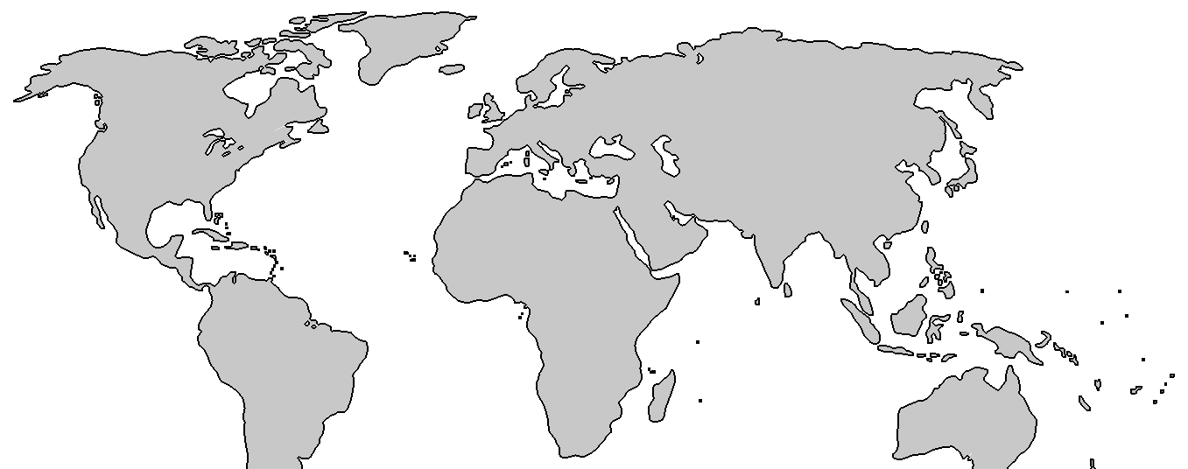
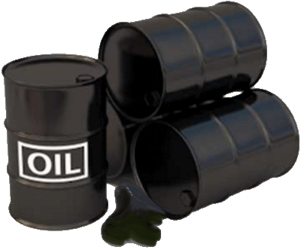


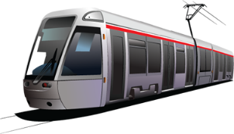
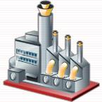
How will China benefit from Yuan becoming SDR-currency?
Other nations can keep yuan in their forex reserve.
More acceptance of Yuan as global currency
Less dependence on $$ while importing oil, metal and food commodities.
May force Indian traders to use yuan (=vulnerability during volatility for India)
SCO, AIIB,BRICS banks - $zone to Yuan zone (strategically buy “off” small nations with yuan infra. Loans, project exports)
Outward expansion of Chinese firms in “upstream” destinations
mining/plantation in LAC (drug-$$ economy),WANA (blood diamond-$$ economy)
SELF STUDY: ML5/P4

Slide 11
REFORM #2: Quota review 2015-16
India earlier 2.44%
Reforms initially proposed in 2010, but stall because needed 70% votes
IMF Financial strength $660 billion (2x than before)

Slide 12

Reform: only “elected” directors
Reforms initially proposed in 2010, but stall because needed 85% votes
BoD
All nations (188)
FinMin / Gov.
Xo.Board
Daily work
MD
Washington
+Staff
Annual Meet
19 “Elected”
5 “Appointed”
5 year (reappoint Yes)
Five largest quota holders: USA, UK, Japan, Germany, France
Notes:
Surveillance: global, regional and national.
Help members in BoP crisis, thus help in international trade
Technical assistance, training, advisory role.

Slide 13

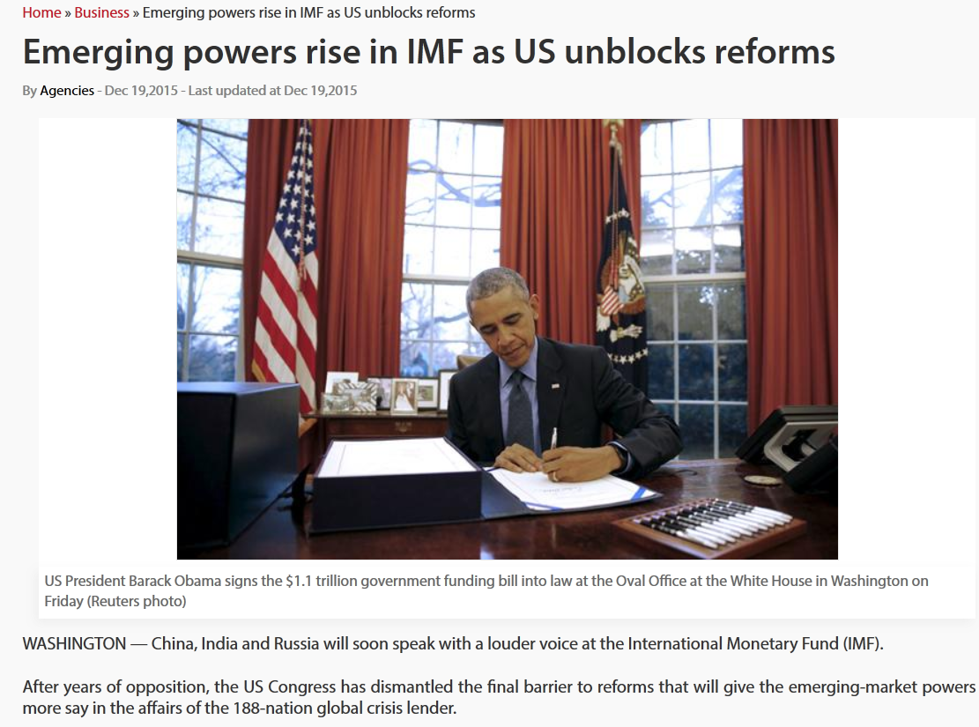
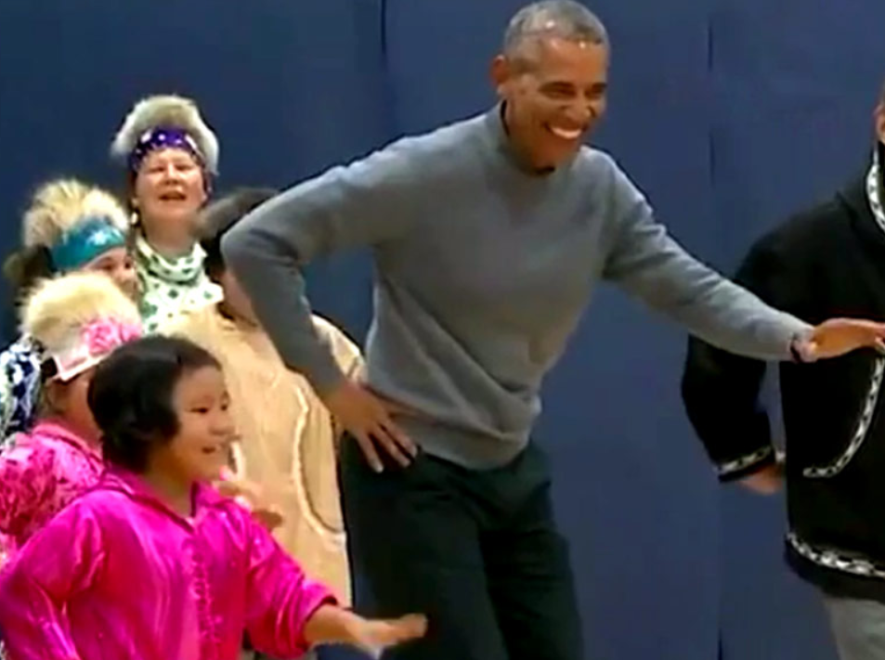
3-reforms: Yuan inclusion, Quota, elected directors
2015, December
I’ll do belly-dance,
if USA votes in favor of IMF-Reforms - Christine Lagarde, October, 2014
Ab bolo :P

Slide 14
Eco Pill #3: International Trade, BoP
Fast Revision + Survey 2015: v2c4, v1c8
BoP #; ECB
Gold Schemes
IMF Reforms
WTO Nairobi
Mauritius DTAA
E-Commerce

Slide 15

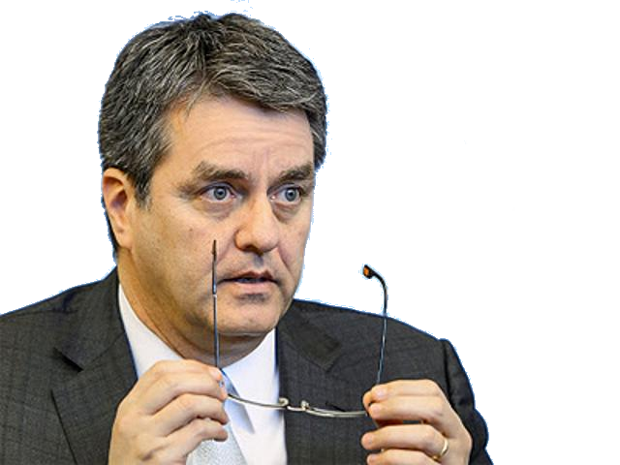
WTO- basics selfstudy L3/P6
WTO Nairobi Package
PTAs benefiting India?

Slide 16

World Trade Organization-Structure
WTO Structure
Ministerial Conference
Secretariat
General Council
164 MEMBERS
9th @Bali’13
Every 2 yr
Appoint DG
Trade agreements
10th Nairobi, Kenya
latest Afghanistan (2015, Dec)
MORE Self study L3/P6

Slide 17
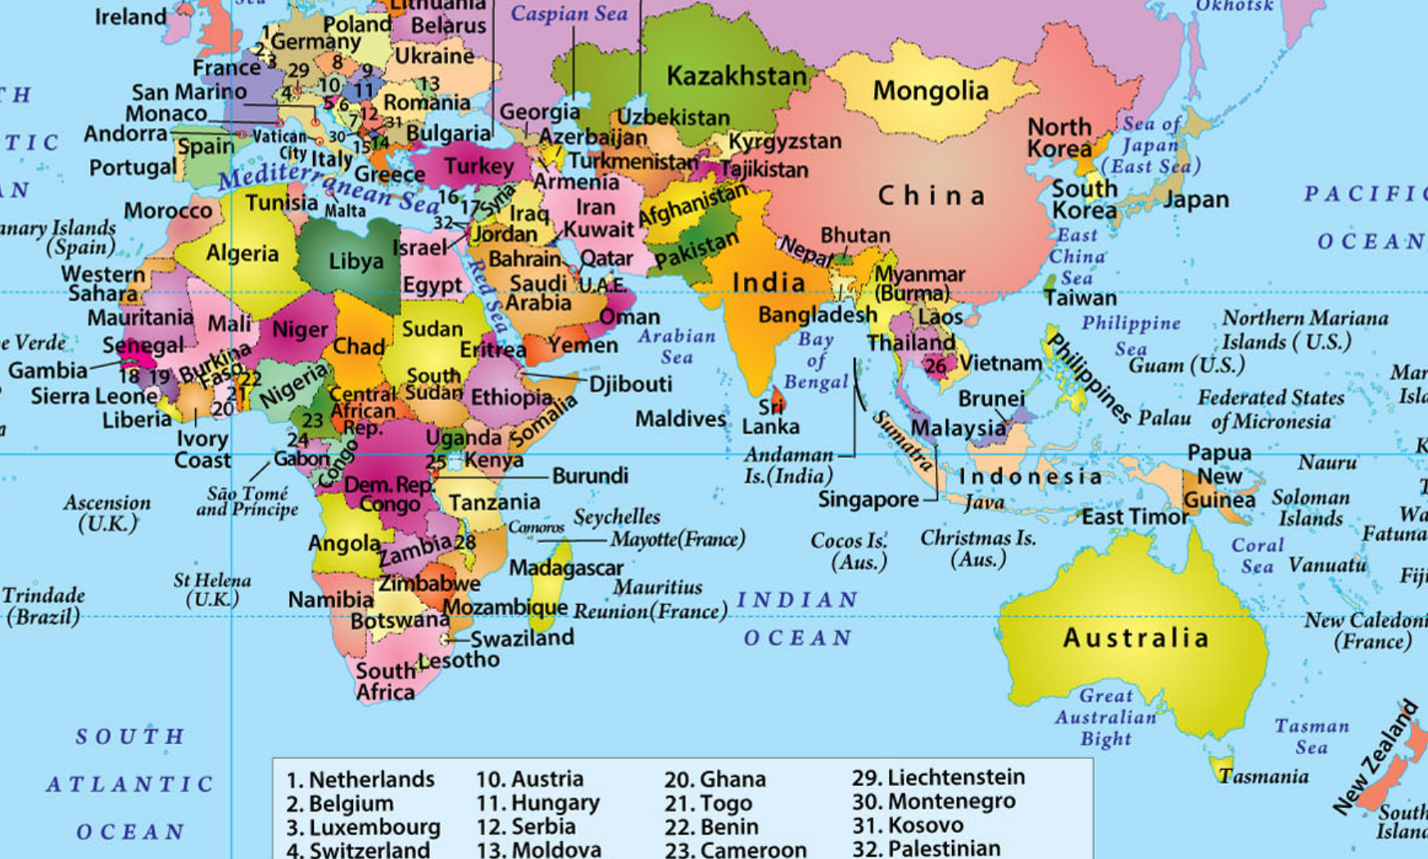
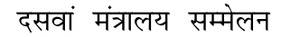
WTO Ministerial conference each 2 years
Nairobi- commitment to ‘advance’ negotiation
India eager, AE- not
HQ: GENEVA
‘01: Doha “Round”
‘13: Bali,9th
Self study L3/P6
‘15: Nairobi,10th
1st time in Africa
‘17: ?? 17th

Slide 18


Customs Clearance
9th Conference-
Trade Facilitation Agreement (TFA)
Bali Summit, Dec 2013
To be Effective from 2015
BEFORE
AFTER
BENEFIT?
Apply, pay fees/taxes Online
Single window for docu.-check
Faster clearance to perishable goods
No middlemen/agent needed
Coordination bodies @ Nat.+Intl.level
▲$1 Trillion GDP
▲ 21 million jobs

Slide 19
TFA What’s new?
WTO-9th
Trade Facilitation Agreement (TFA) to ease custom norms
Need 2/3rd ratification (108/162) but so far 69 ratified
India RATIFIED, will setup a National Committee on Trade Facilitation (NCTF)
NCTF to be jointly chaired by the commerce and revenue secretary.

Slide 20

WTO: Nairobi Package (2015,Dec)
Agri: Export Subsidies, SSM
L.D.C
Info. Tech. Agreement
Patent Evergreen
Criticism

Slide 21
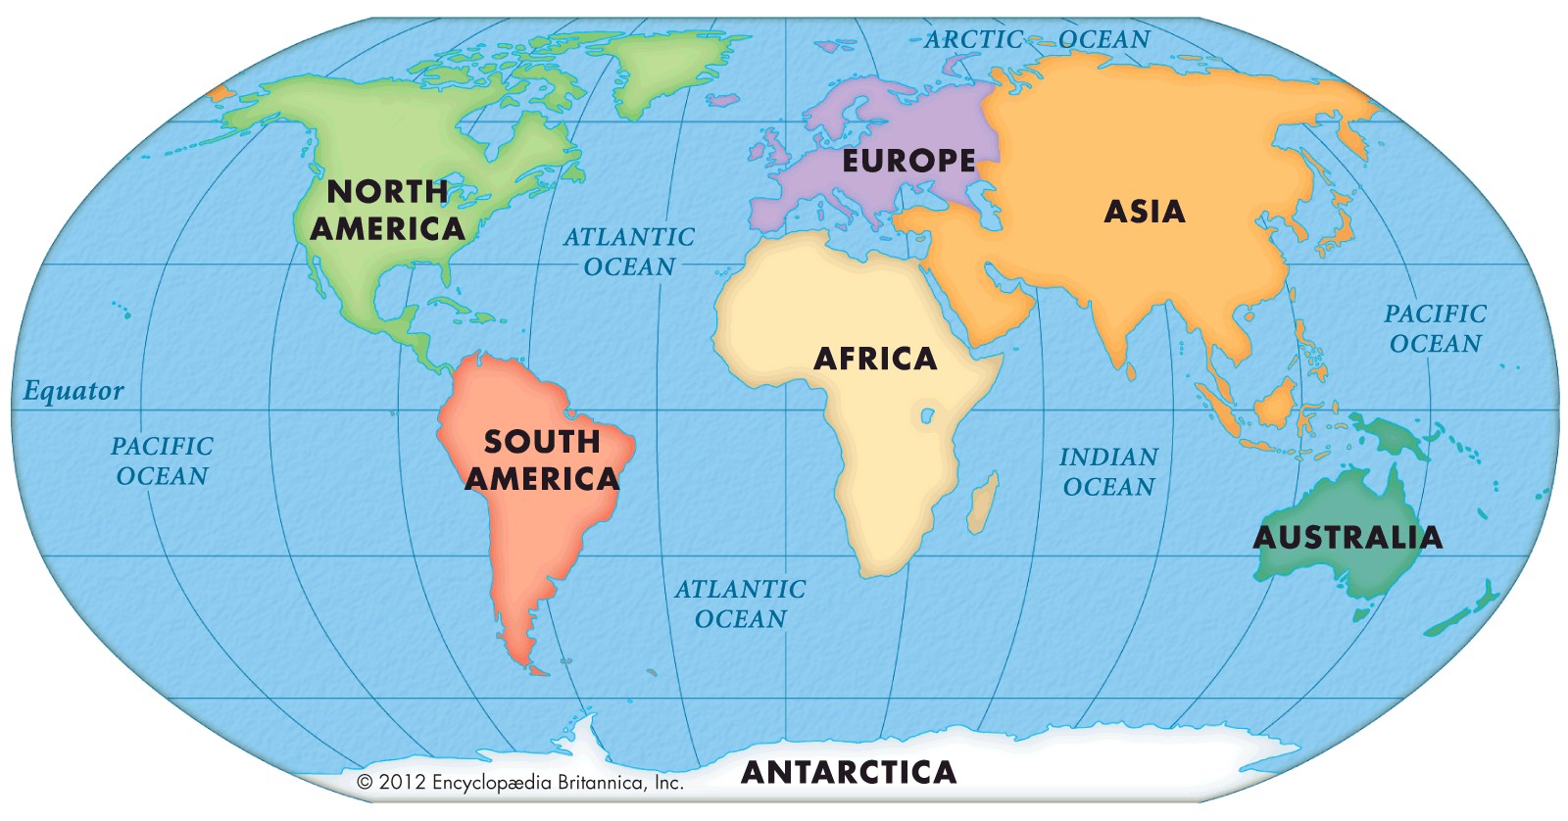
Nairobi Package #1: Agro export subsidies
Canada, Swiz, Norway: extended deadline 2022 for dairy, meat, processed food
2018: Export Subsidies
2023: Transport / marketing subsidies
Immediately
Public stockholding
“Peace clause” to continue until permanent solution is found L3/P6
Deadline 2030
For poorest & food-importing
Notes:
+ financial discipline to giving credit to agri-exporters

Slide 22
Nairobi Package #2: Cotton Export
1st Jan 2017:
Cotton Export Subsidies
Immediately
L.D.C. Cotton export
Duty free quota free access
Notes:
By 2017-18
begin process

Slide 23


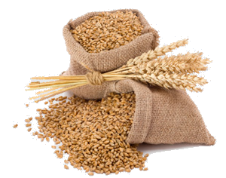
Special safeguard mechanism (SSM)
Economies of scale
High R&D, Mechanization
Cheaper production
(even if no subsidies)

Slide 24

Special safeguard mechanism (SSM)
SSM Special safeguard mechanism against cheap import surges
Benchmark?
Import Quantity / Price Surge
WTO Committee will decide

Slide 25
WTO: Nairobi Package
Agri: Export Subsidies, SSM
L.D.C
Info. Tech. Agreement
Patent Evergreen
Criticism

Slide 26
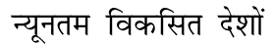


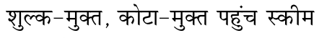
L.D.C
Upto 75% of Final value
Duty free quota free access
Substantial transformation
Inception
Hong Kong summit (2005)
India 1st country to help, incl. free biz visa. 31 out of 48 L.D.C covered
Notes:
https://www.oecd.org/tad/events/relevance-of-WTO-MC10-for-Agriculture-draft.pdf

Slide 27
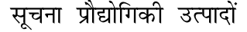


Information Technology Agreement (ITA)-1996 (Singapore)
0% Tariff on 201 IT products
~82 members- both 1st and 3rd world; India not a party but exporters eligible to access
~$1.3 trillion trade per year
Nairobi- Fully implement by 2019
Notes:
https://www.wto.org/english/news_e/news15_e/mc10_19dec15_e.htm
WTO members secure landmark $1.3 trillion IT trade deal
In another significant outcome from the Nairobi Ministerial, WTO members representing major exporters of IT products agreed on 16 December on the timetable for implementing a landmark deal to eliminate tariffs on 201 information technology products valued at over $1.3 trillion per year.
Negotiations on the expanded Information Technology Agreement (ITA) were conducted by 53 WTO members, including both developed and developing countries, which account for approximately 90 per cent of world trade in these products. However, all WTO members will benefit from the agreement, as they will all enjoy duty-free market access to the markets of the members eliminating tariffs on these products.
The list of 201 products was originally agreed by the ITA participants in July 2015.
This breakthrough followed months of intensive negotiations among the ITA participants. Their review of “draft schedules” involved a process whereby each of them indicated over what timeframe and how they intended to implement the elimination of duties on these products.
For every product on the list, ITA participants have negotiated the level of reductions and over how many years it will fully eliminate the tariffs. As a result of these negotiations, approximately 65% of tariff lines will be fully eliminated by 1 July 2016. Most of the remaining tariff lines will be completely phased out in four stages over three years. This means that by 2019 almost all imports of the relevant products will be duty free.
More details on the Agreement are available here.

Slide 28

Ever greening of Patents: Self study- L6/P4
All members will take strict actions to prevent ever greening of patents
Affordable generic drug supply ensured
Notes:
Evergreening = above 20 years.

Slide 29
WTO: Nairobi Package
Agri: Export Subsidies, SSM
L.D.C
Info. Tech. Agreement
Patent Evergreen
Criticism

Slide 30

Nairobi Summit
#EPICFAIL
SSM: no concrete decision on benchmarks.
Fishing subsidies….China, India opposed, no decision. [Survey: India shd shed “Big but poor” dilemma to gain more]
Give more power’s to WTO’s anti-dumping Committee ….India opposed, no decision

Slide 31
List of major “Pangaa” going on: IYB-2016, Page 174
WTO Structure
Ministerial Conference
DG
General Council
Day2day D/M
Bodies
@Geneva
Trade Policy review
Dispute settlement

Slide 32
India’s major trade disputes @WTO
Avian influenza
USA won, India wants time to implement
USA imposed CVD on Indian steel
India won, USA wants time to implement
Solar Subsidies @JN-Solar Mission Phase-1,2
USA won. India to file counter cases against USA’s own state programs
Notes:
http://www.catchnews.com/business-economy-news/wto-battles-how-india-wants-to-pay-us-in-its-own-coin-1463588292.html
California made solar panels = 20% discount.

Slide 33


WTO- basics self-study L3/P6
WTO Nairobi Package
PTAs benefiting India? V1c8

Slide 34
Foreign trade
Direct proportion to size of economy
Indirect proportion to “Distance”
Language, Policy, Political system
Notes:
Evergreening = above 20 years.
trade flows between countries are directly proportional to the “size” of the two countries - as measured by GDP - and inversely proportional to the distance between them. Distance is a proxy for all trade costs between countries, including not just transport costs, but also those related to language, currency, policy etc. The idea being that countries having a similar language, currency, political system or colonial links are more likely to trade with each other because all costs other than transportation will be lower

Slide 35
Classification of Trade Agreements
Partial Scope Agreement
# of Participants
Integration Level
Bi-lateral
Regional
Multilateral
Free Trade Agreement (FTA)
Customs Union (CU)
Common Market (CM)
Economic Union (EU)
Trade Agreements

Slide 36
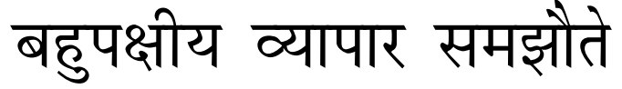
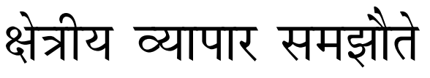
Trade agreements- based on # of participants
WTO | MTA
Best solution for deepening intl. trade
Slower, because need Broad-based consensus
TPP, TATIP, NAFTA | RTA
Regionally confined
More Political in nature, More discriminatory to even ‘better exporter’ non-member
“More Equitable”- care for L.D.C.
Less equitable. Even if L.D.C is member- less ‘voice’.
India: open, equitable, predictable, non-discriminatory , rule-based intl. trading system. RTAs as building blocks for MTA.

Slide 37
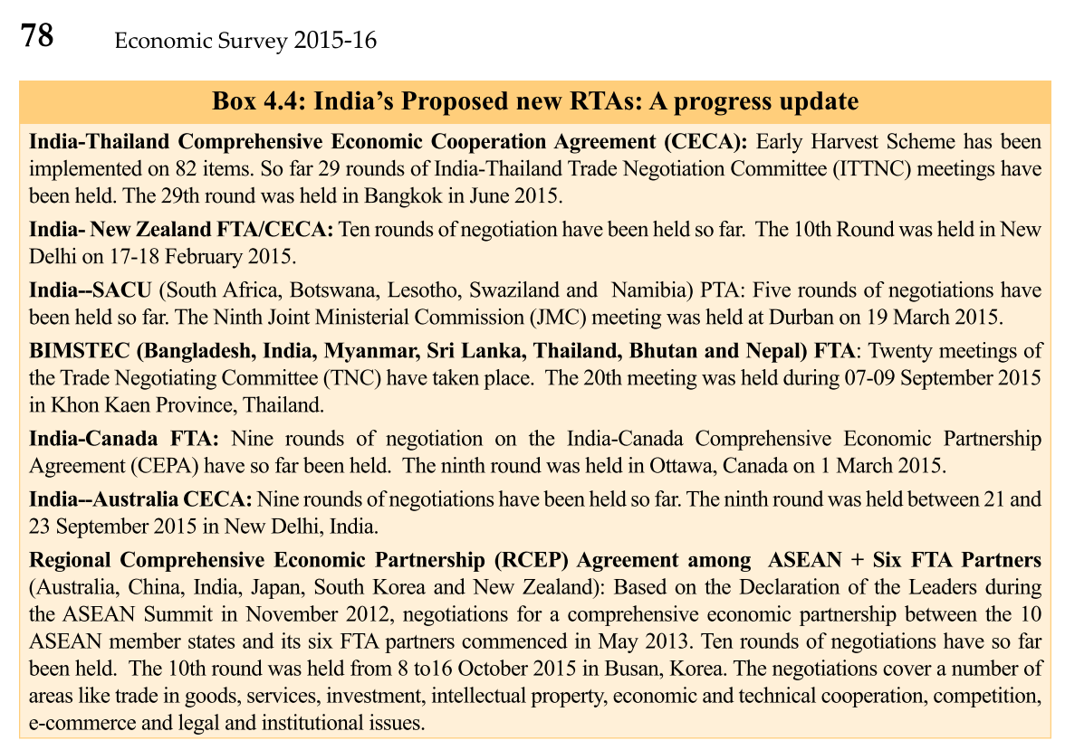

Slide 38
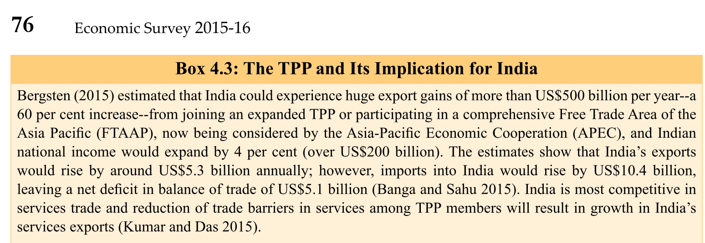
L6/P2 IR2/P2
Box 4.3 in v2c4

Slide 39
Survey, 2015
According to survey, TPP will hurt India through
Investment diversion to TPP countries
Erosion of India’s export-share to US and Europe.
Stiff competition in textile from Vietnam and others.
All of above.
Right answer

Slide 40

Classification of Trade Agreements
Partial Scope Agreement
# of Participants
Integration Level
Bi-lateral
Regional
Multilateral
Free Trade Agreement (FTA)
Customs Union (CU)
Common Market (CM)
Economic Union (EU)
Trade Agreements
Level of integration
619 signed in whole world

Slide 41
5 PTAs
#1: Partial Scope Agreement (PSA)
Trade between countries on a small number of goods.
#2: Free Trade Agreement (FTA)
member: lower tariff; non-members: regular tariff
TPP, TATIP = FTAs on Steroids, India joined neither
All FTAs are not same, India Japan-FTA has tech. regulation but India-Korea CEPA doesn't have it.

Slide 42
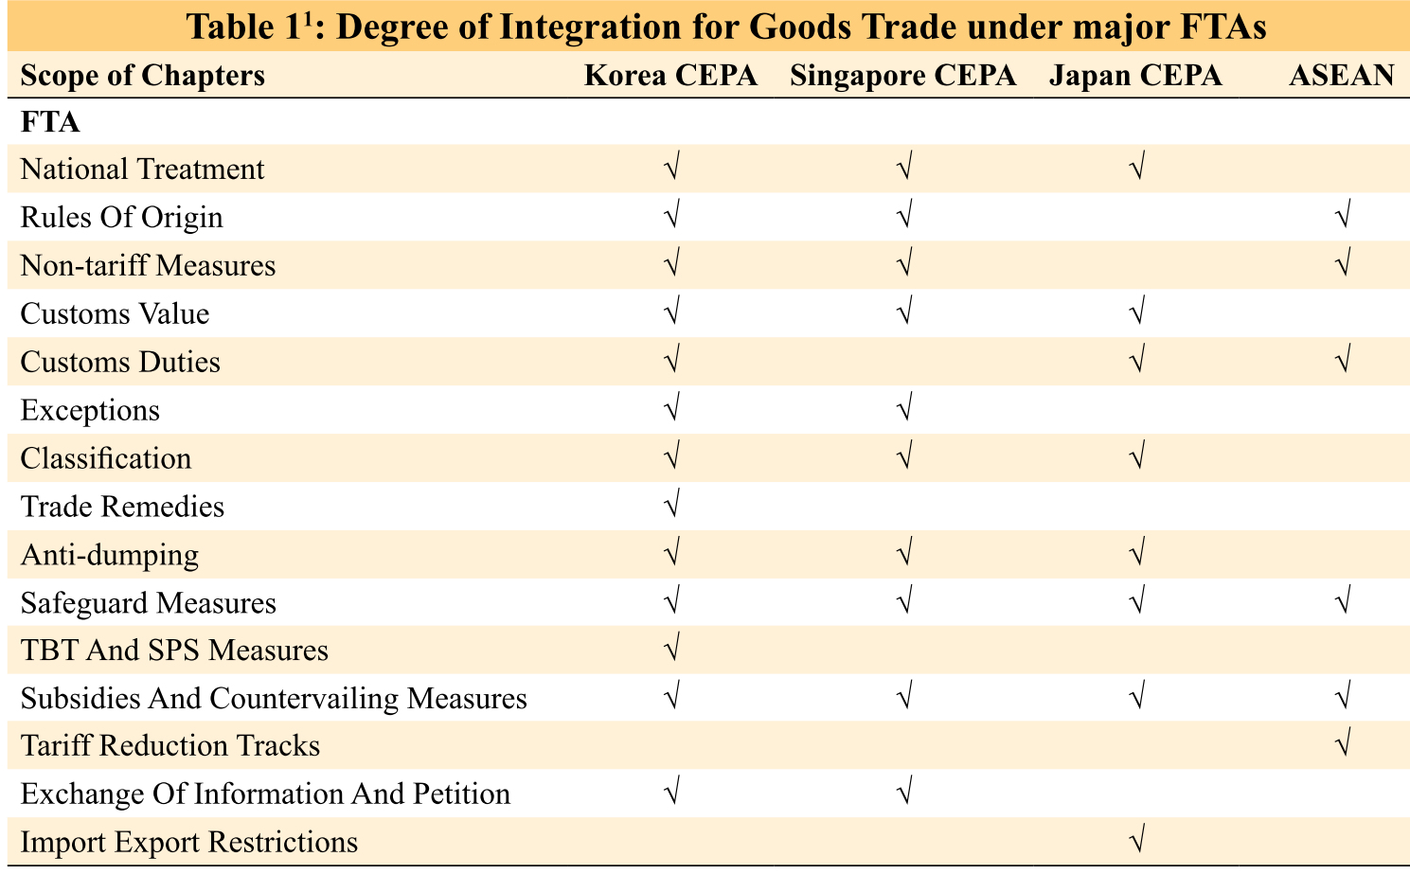
All FTAs not same: Survey v1c8 page 120

Slide 43
5 PTAs
#3: Customs Union (CU)
FTA in which members apply a common external tariff (CET) for non- members [CARICOM]
#4: Common Market (CM)
customs union where factors of production (capital, labour) can move freely amongst members [MERCOSUR- S.America]
#5: Economic Union (EU)
common market where member countries coordinate macro-economic and exchange rate policies.

Slide 44
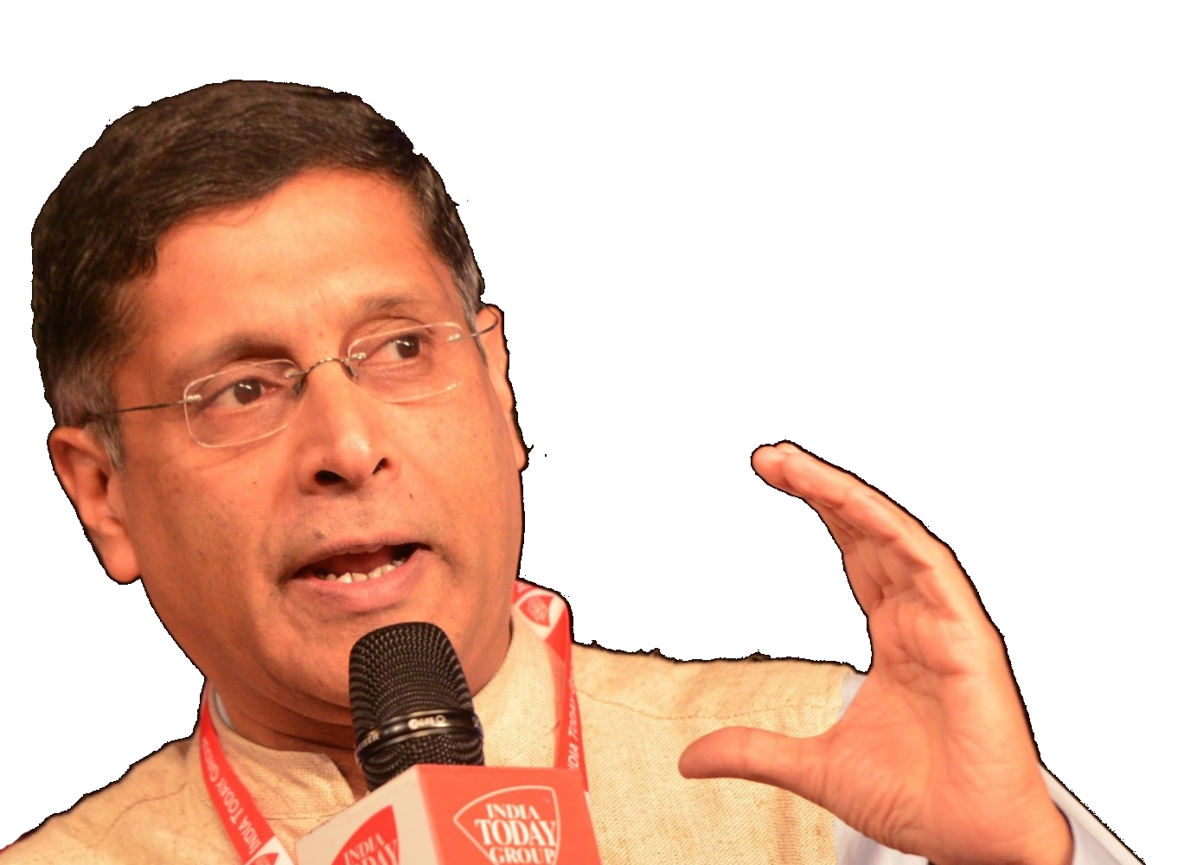
India= 42 FTAs, Overall, worked well so far
benefits
FTA = ▲trade by 50% in 4 years
But ▲on import side > export side
▲ export dynamism in metal trade and apparels- in ASEAN markets.
WTO processes taken over by RTA
India must prepare for a mega-regional world. (RCEP, TATIP, TPP)
Should shed “Big but poor” dilemma- i.e. have to open up, give and take, can’t be “protective” of local industry 24/7

Slide 45
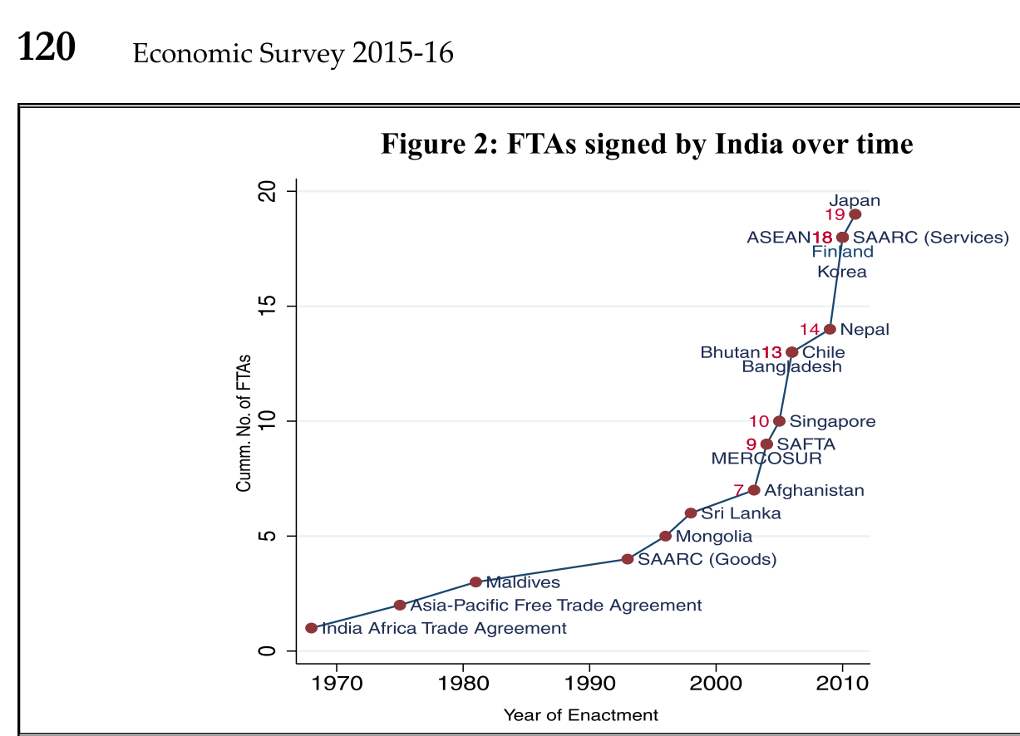
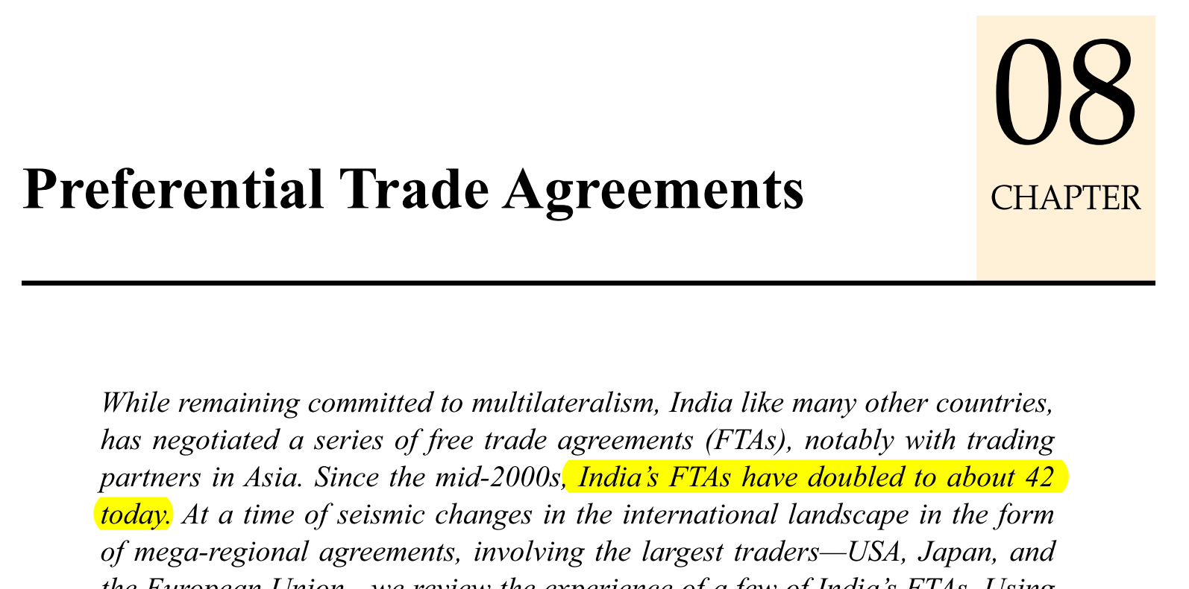
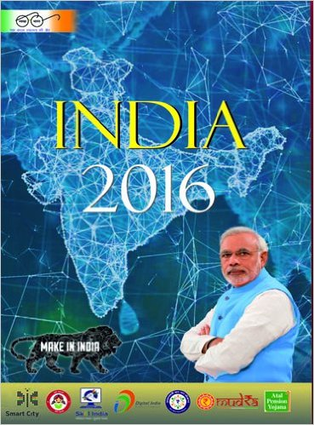
Some inconsistency in factoids
IYB-2016: Page 186 Chronology of FTAs already in place

Slide 46
Yearbook 2016 ch.7
Department of Commerce looks after
Special Economic Zones (SEZ)
Foreign Trade Policy
Liaison with WTO, Regional and Bilateral Trade Agreements
All of above

Slide 47
Fast Revision + Survey 2015: v2c4, v1c8
BoP #; ECB
Gold Schemes
IMF Reforms
WTO Nairobi
Mauritius DTAA
E-Commerce

Slide 48

Theory +Economic Survey Vol.2 + Vol.1 + Budget 2016
1.Banking Finance
6.HRD
2.Budget-Fiscal Policy
3.BoP
4.Sectors of Economy
5.Infra
V2C2-Pub.Fin; V1C3-JAM
V2C3-Monetary mgmt+FI
V2C4-External sector
V2C5-Price,Agri.; V2C6,7
V2C8-Paris Summit, Energy
V2C9-Social infra.
V1C4-Agri ; V1C9-Fertilizer
V1C5-mother-child
V1C6-bounties; V1C7-Fiscal Cap
V1C8-PTA
V1C2-Chakravy; V1C10-Labour
V1C11-Powering 1 India
B1. Financial Sector Reforms
B2. Fiscal Discipline
B3. Tax Reforms; B4. Ease of
B5. Agro: 2x farmer income
B6. Rural infra-employment
B7. Infrastructure
B8. Social Sector & healthcare
B9. Education, Skills, Jobs
V2C1- Chakravyuh challenge
V1C1- Twin Balancesheet
IYB:7-Commerce

Slide 49
Theory +Economic Survey Vol.2 + Vol.1 + Budget 2016
1.Banking Finance
6.HRD
2.Budget-Fiscal Policy
3.BoP
4.Sectors of Economy
5.Infra
V2C2-Pub.Fin; V1C3-JAM
V2C3-Monetary mgmt+FI
V2C4-External sector
V2C5-Price,Agri.; V2C6,7
V2C8-Paris Summit, Energy
V2C9-Social infra.
V1C4-Agri ; V1C9-Fertilizer
V1C5-mother-child
V1C6-bounties; V1C7-Fiscal Cap
V1C8-PTA
V1C2-Chakravy; V1C10-Labour
V1C11-Powering 1 India
B1. Financial Sector Reforms
B2. Fiscal Discipline
B3. Tax Reforms; B4. Ease of
B5. Agro: 2x farmer income
B6. Rural infra-employment
B7. Infrastructure
B8. Social Sector & healthcare
B9. Education, Skills, Jobs
V2C1- Chakravyuh challenge
V1C1- Twin Balancesheet
IYB:7-Commerce

